Slide 1
Title Text Arial 40 pt
March 16, 2022

Slide 2
Title Text Arial 40 pt
March 16, 2022
Arial Subhead 16 pt

Slide 3
Automating Containerized Deployments with GitHub Actions Pipelines
Load balancer implementation - Utilities
Marcus Hilliard, David Maples, Adam Gibbons
ECE-4383
OL Team 2

Slide 4
Project Goals
Implement and showcase the purpose and utility of a load balancer for traffic distribution
Automate building and deploying procedures using GitHub Actions, pushing the pipeline-created image to a container registry.

Slide 5
Automating deployments with container registries & actions
A dev pushes code to the targeted repository, the devs contribution is then merged into the main branch after PR
After merging a pipeline build is kicked off where the code will be built, tested, and an image will be deployed to a container registry
The cluster will pick up the latest version of the image from the container registry

Slide 6
What is CICD?
Continuous integration
Automatically integrating new code changes
Continuous testing
Automated unit testing to fail fast
Continuous delivery
Automatically deploying built and tested code changes

Slide 7
Github Actions Pipelines an overview
GitHub Actions serves as an integrated CICD automation platform within the GitHub ecosystem.
It enables the automatic building, testing, and deployment of code stored within a repository.
The platform includes the capability to build code into an image and deploy it seamlessly to a Kubernetes cluster.
Setting up GitHub Actions for CICD is relatively straightforward.

Slide 8
Why use a pipeline?
Automation Streamlines Development: Automates intricate command-line inputs, simplifying code development for increased efficiency.
Error Reduction in Code Processes: Reduces labor and error risks in building, testing, and deploying code changes systematically.
Accelerates Development: Team members consistently integrate and test code, receiving immediate feedback for streamlined development.
Detailed Error Logs in Pipeline: Provides thorough feedback and logs, pinpointing potential errors throughout the build and deployment processes.

Slide 9
What is a container registry?
Centralized Repository: Stores and manages container images, acting as a centralized location for distribution.
Version Control: Tracks and organizes different versions of container images, facilitating version control and rollback.
Access Control: Implements security measures to control and restrict access to container images based on permissions.
Integration: Integrates with other CICD tools, streamlining deployment and management of containerized applications.

Slide 10
Putting it all together
Set up the initial Github workflow structure in the repository
Develop a detailed pipeline.yaml configuration file that will build and push a docker image to a container registry
Implement logging functionalities in the pipeline configuration to improve debugging and error transparency
Deploy directly to our cluster from the container registry

Slide 11
Load balancer Overview

Slide 12
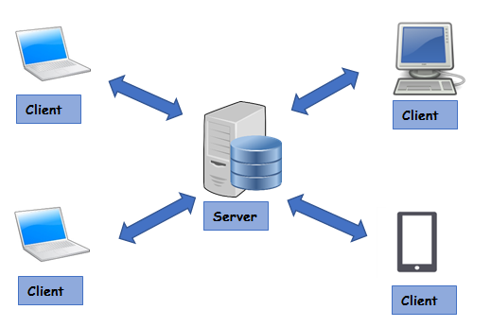
Inherent Difficulties With Overloaded Servers
A server can be overloaded with clients easily so we can send millions of messages making one server work too hard.

Slide 13
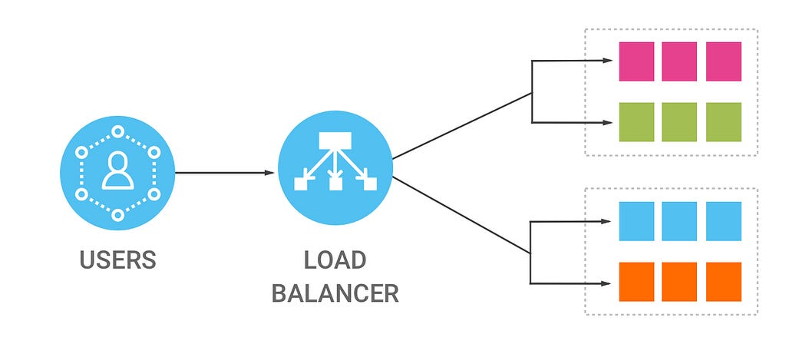
The Solution
A load balancer takes messages or data from clients and efficiently distributes the data to servers.

Slide 14
Load Balancer Implementation plans
Use the code we developed for the client health server implementation
Iterating over 1000 trials locally, we will collect a baseline of latency data
Make a replica set and use the Kubernetes default load balancer and record the latency data after 1000 more iterations
Using Linkerd’s Load Balancer we will be able to decrease latency and gather additional metrics after 1000 more iterations

Slide 15
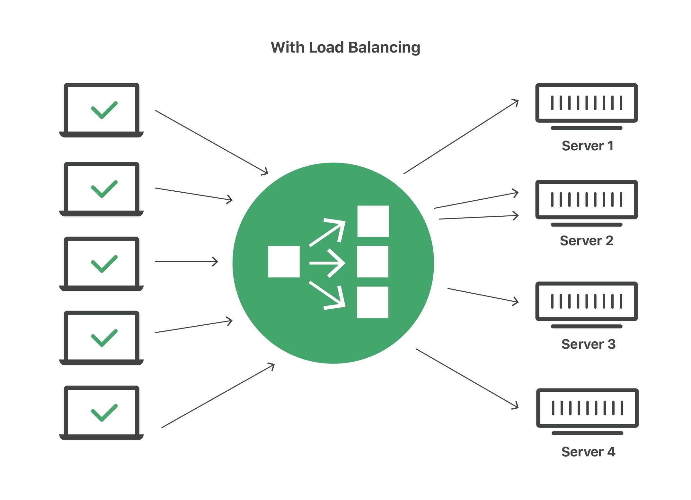
Load Balancer Implementation plans
Kubernetes Load Balancer
Randomly picks a pod to receive message.

Slide 16
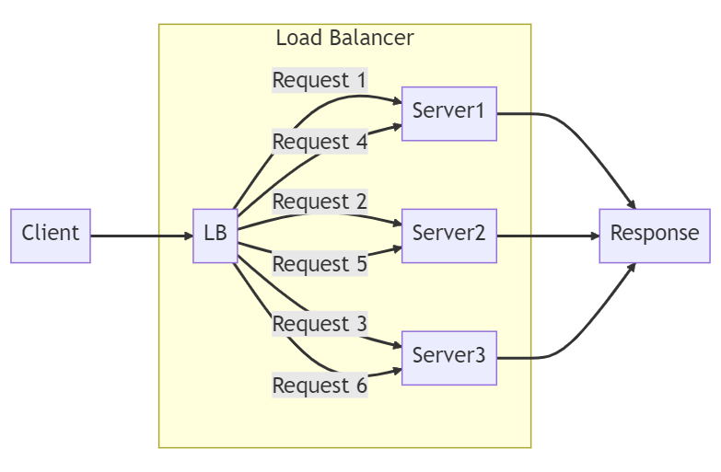
Load Balancer Implementation plans
Linkerd Static Load Balancer
Pods receive traffic in an incremental order.

Slide 17
Load Balancer Implementation plans

Slide 18
Load Balancer Capabilities
Performance benefits - High load network scalability
Hot swap images with no downtime seamlessly
More robust system

Slide 19
Expected conclusions
A demo that will push to an ACR
Configuring a load balancer

